Slide 2
What is the Circle of Peers?
Circle of Peers was launched in 2007
We recognised that People Professionals valued opportunities to meet and exchange experiences
These events provide a support mechanisms for our candidates
Circle of Peers events are good for People Professionals who give so much to others and yet do not take care of themselves

Slide 3
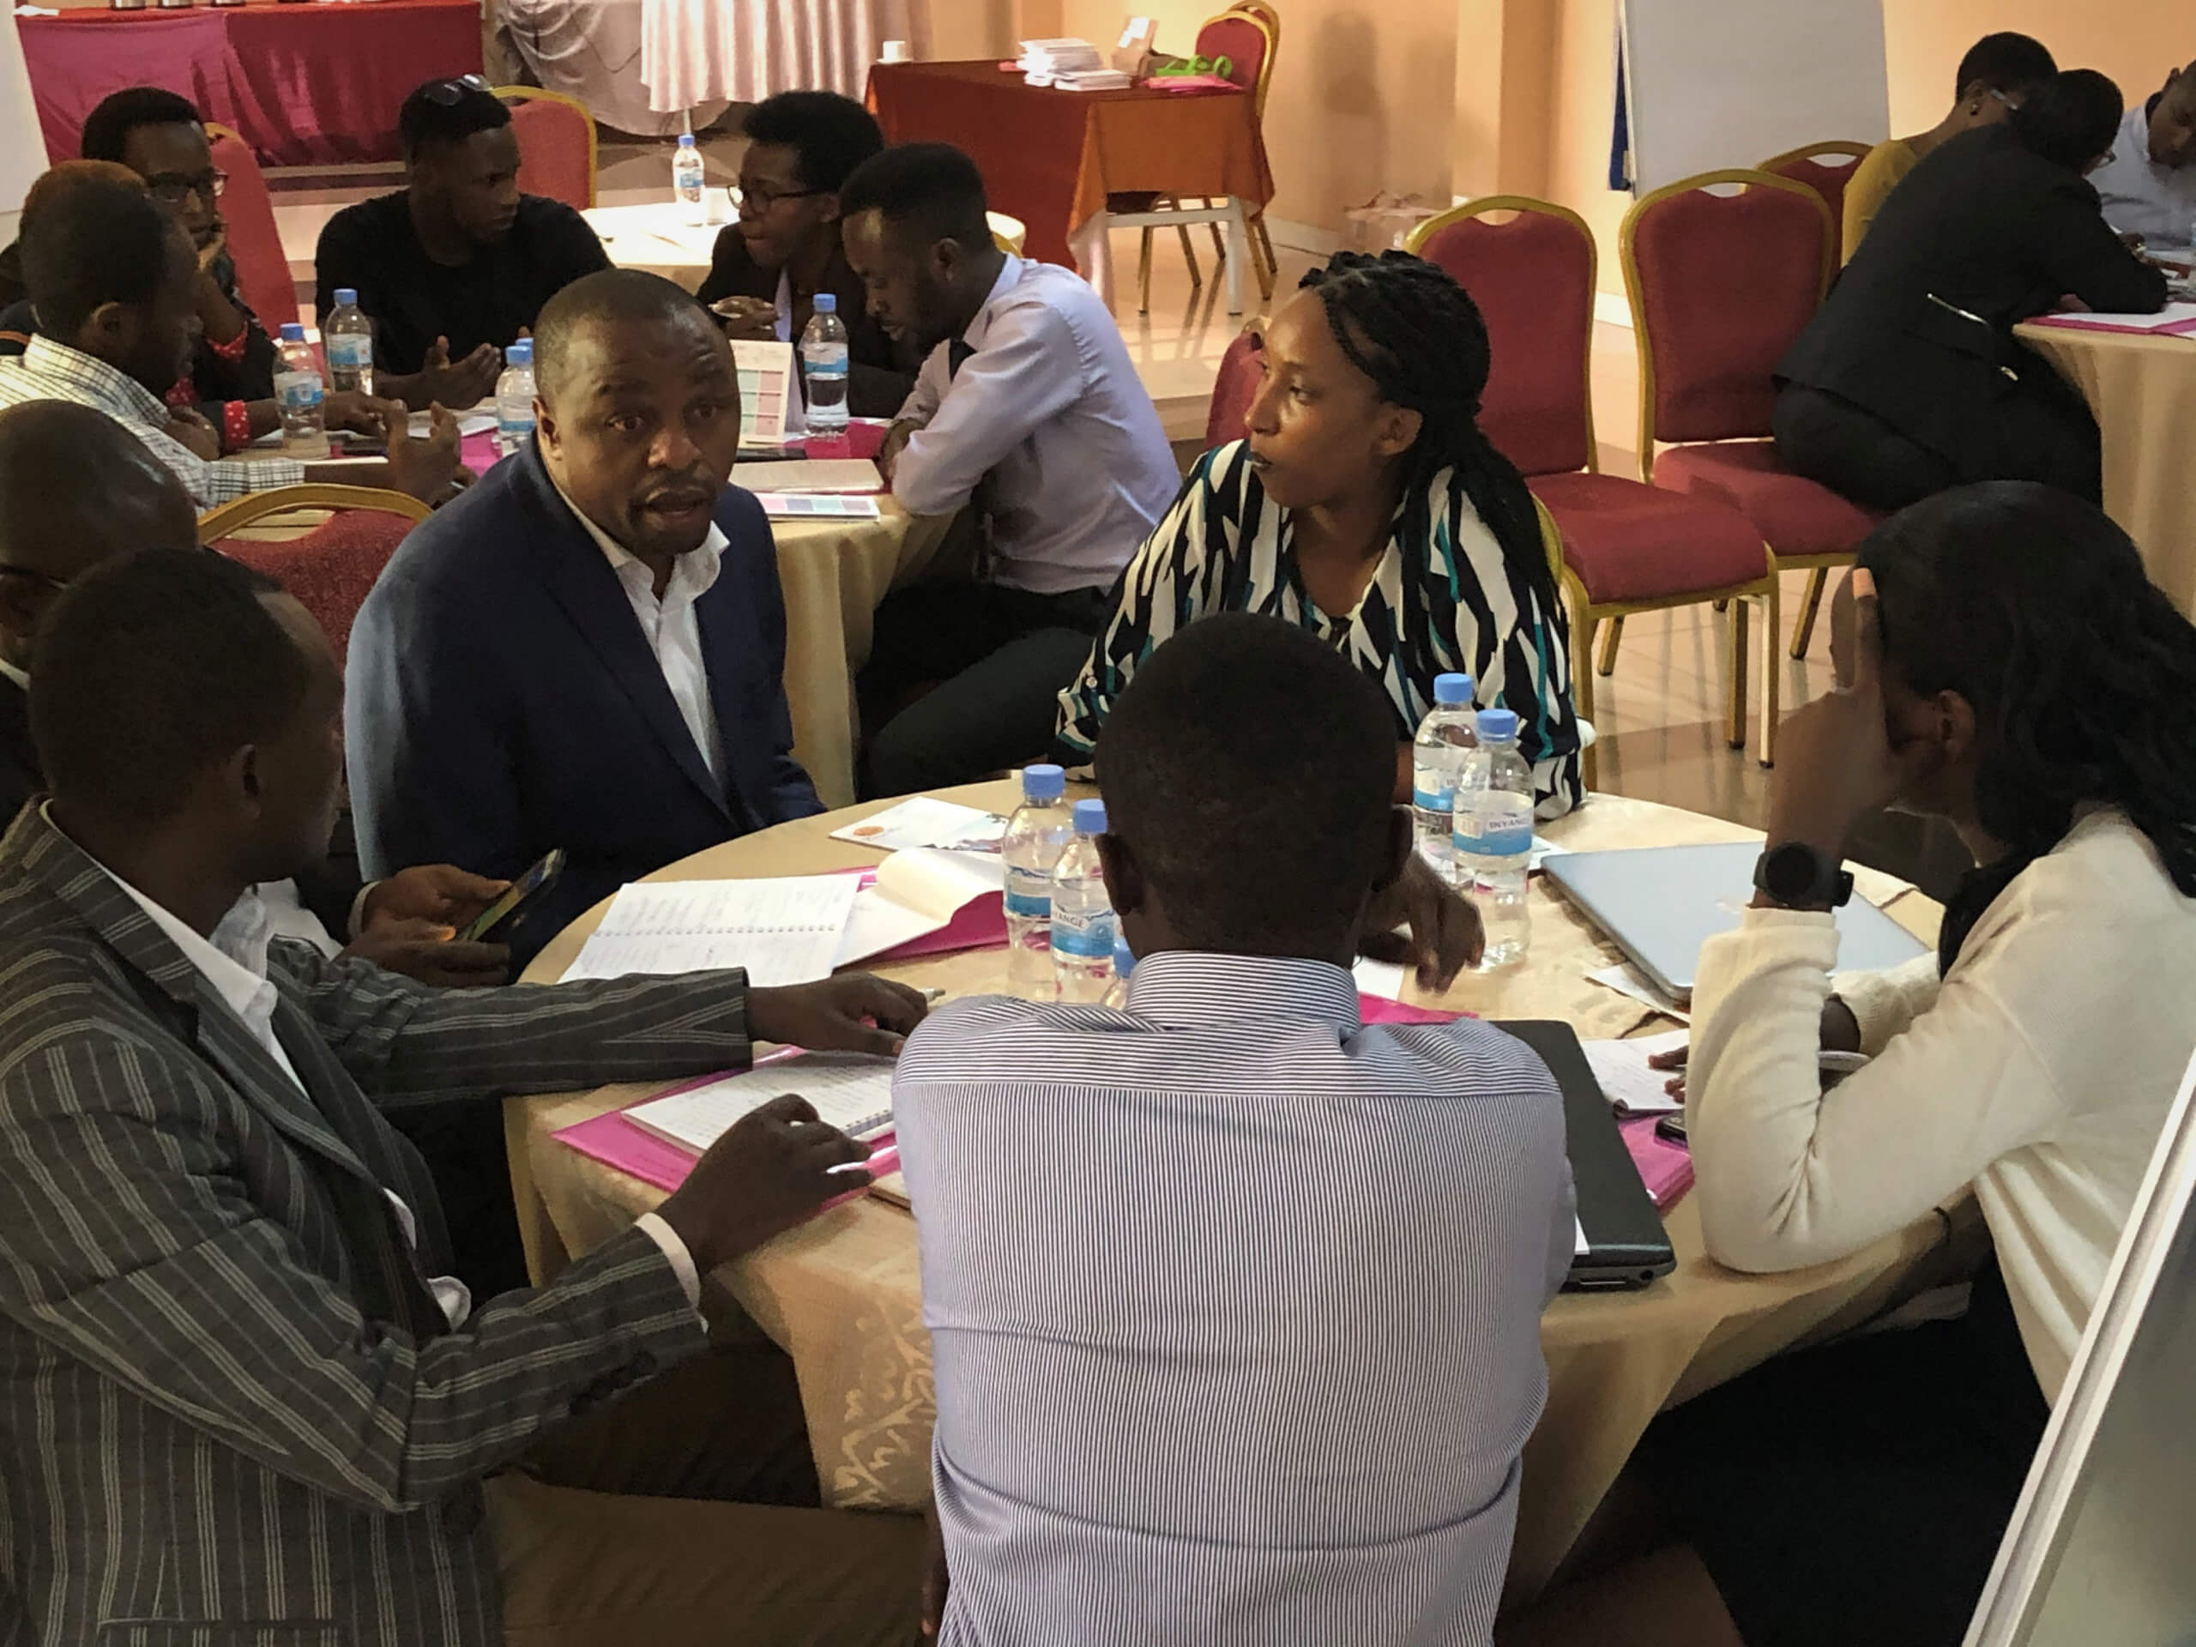
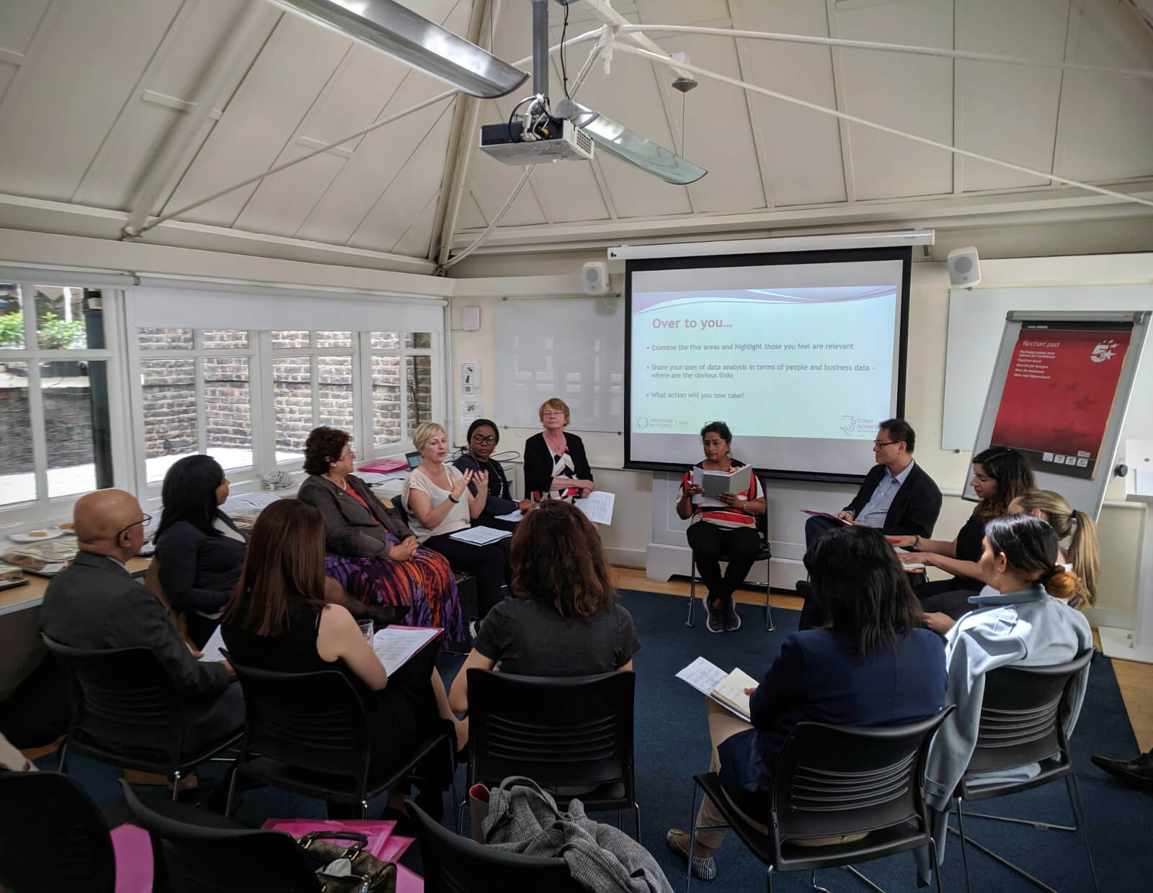

Slide 5
Shifting Tides
Shifting sands too static for our times!
5

Slide 6
Leaders and managers - theme for 2023
People professionals must:
Focus on this to add maximum impact
Re-evaluate their current approaches
Work collaboratively with the C suite
Research to get the ultimate design right

Slide 7
Looking to the future

Slide 8
Constant change …
Will be shaped by where work is going. Trends are:
Technology
Changes to CIPD Profession Map
People valuing choice
Leaders and managers feeling out of their depth
Importance of return on investment

Slide 9
Our guest speaker
Alison Carter
Principal Research Fellow
Institute of Employment Studies
(IES)

Slide 10
Workplace coaching …
Will be shaped by where work is going. Changes here and on the horizon are:
The role of leaders and managers are changing
The workplace is changing
Workers are changing

Slide 11
How do we evaluate the impact?
We need to consider:
Validation
Evaluation
ROI
Cost benefit analysis

Slide 12
Coming soon ….

Slide 13
How was it for you?
What will you add to your CPD record?
Any feedback for us?
What other areas would you like us to explore?

Slide 14
Thank you
Maureen Scholefield
develop@cullenscholefield.com
www.cullenscholefield.com

